Slide 1
GPGPU-Sim Overview
Roland Green, Purdue University
11/03/2019
SST Development Team, Sandia National Laboratories
Architecture Accelerator Lab, Purdue University
SAND2019-13453 C

Slide 2
Welcome!
Part 1: Introduction to SST 8:45 - 10:15
SST Overview
Demos: Running a simple simulation; Enabling statistics; Running in parallel
SST Element Libraries: A tour
Break 10:15 - 10:45
SST Element Libraries: A tour
Demos: L2 Cache; Backing store; Adding processors; Adding Memory; Node modeling
Lunch 12:00 - 1:30
Part 2: GPGPU-Sim 1:30 – 2:30
GPGPU-Sim Overview & New Features
Part 3: The SST/GPGPU-Sim Integration 2:30 - 3:00
Break 3:00 - 3:30
GPGPU-Sim Exercises 3:30 - 5:00

Slide 3
Outline
GPGPU-Sim Introduction
GPU and programming model
Functional model
Performance model
GPUWattch: power model
New Features in GPGPU-Sim
Volta model
Run closed source libraries
Tensor Core
Run CUTLASS library
Notes:
Description provided in ASC CSSE Milestone 6812.
Prior to this milestone, SST lacked the capability to model any external accelerator. We are now able to model a GPU accelerator in detail and analyze application and system behavior in fine detail.

Slide 4
Acknowledgements
Some slides are credited to GPGPU-Sim Micro Tutorial 2012
Some data and figures are credited to papers below:
Akshay Jain, Mahmoud Khairy, Timothy G. Rogers, A Quantitative Evaluation of Contemporary GPU Simulation Methodology. SIGMETRICS 2018
Mahmoud Khairy, Jain Akshay, Tor Aamodt, Timothy G Rogers, Exploring Modern GPU Memory System Design Challenges through Accurate Modeling, arXiv:1810.07269, ( and ISPASS 2019 poster)
Jonathan Lew, Deval Shah, Suchita Pati, Shaylin Cattell, Mengchi Zhang, Amruth Sandhupatla, Christopher Ng, Negar Goli, Matthew D. Sinclair, Timothy G. Rogers, Tor M. Aamodt, Analyzing Machine Learning Workloads Using a Detailed GPU Simulator, arXiv:1811.08933, ( and ISPASS 2019 poster)
Md Aamir Raihan, Negar Goli, Tor Aamodt, Modeling Deep Learning Accelerator Enabled GPUs, ISPASS 2019
We thank all contributors to GPGPU-Sim
All new features are based on the dev branch of GPGPU-Sim: https://github.com/gpgpu-sim/gpgpu-sim_distribution/tree/dev
Notes:
Description provided in ASC CSSE Milestone 6812.
Prior to this milestone, SST lacked the capability to model any external accelerator. We are now able to model a GPU accelerator in detail and analyze application and system behavior in fine detail.

Slide 5
Outline
GPGPU-Sim Introduction
GPU and programming model
Functional model
Performance model
GPUWattch: power model
New Features in GPGPU-Sim
Volta model
Run closed source libraries
Tensor Core
Run CUTLASS library
Notes:
Description provided in ASC CSSE Milestone 6812.
Prior to this milestone, SST lacked the capability to model any external accelerator. We are now able to model a GPU accelerator in detail and analyze application and system behavior in fine detail.

Slide 6
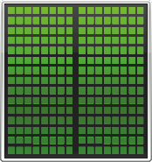
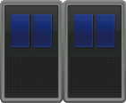
GPU Introduction
GPU = Graphics Processing Unit
Optimized for Highly Parallel Workloads
Highly Programmable
Heterogeneous computing
NVidia Tesla GV100: 80 Stream Multiprocessors(SMs)
Each SM has 64 INT32, 64 FP32, 32 FP64, 8 Tensor core
Notes:
Completion criteria for ASC CSSE Milestone 6812.
Please see the last slide on how we have met each of these criteria.

Slide 7
GPGPU Programming model evolution
GPGPU programming model:
CUDA and OpenCL
Support more features with newer architectures
CUDA 9.X
Cooperative groups
MPS
CUTLASS
Tensor core operation
(Volta)
CUDA 6.X
Unified memory
Dynamic Parallelism
cuDNN
(Kepler, Maxwell)
CUDA 1.X
C compiler
(Tesla)
CUDA 3.X
C++ compiler
(Fermi)
CUDA 4.X
C++ new/delete
No-copy system memory
CUDA 10.X
CUDA Graphs
(Turing)
CUDA
2008
2011
2013
2015
2007
2010
2014
2017
2019
OpenCL
OpenCL 2.1
C++14
SPIR-V
for Vulkan
subgroup
OpenCL 1.0
C99 support
OpenCL 1.2
Device Partition
Built-in kernels
OpenCL 2.0
Shared virtual memory
Nested Parallelism
Pipe
OpenCL 2.2
C++14
SPIR-V 1.1
Notes:
Impact statement from ASC CSSE Milestone 6812.
This is a stepping stone to achieve these goals; we still have some work to do. SST+GPU is the state-of-the-art in simulation capabilities. A literature review will reveal that, with this addition, SST provides more than other node-level simulation tool.
As we continue working on the GPU, memory, and interconnect models, we will get closer and closer to each of these impact statements.

Slide 8
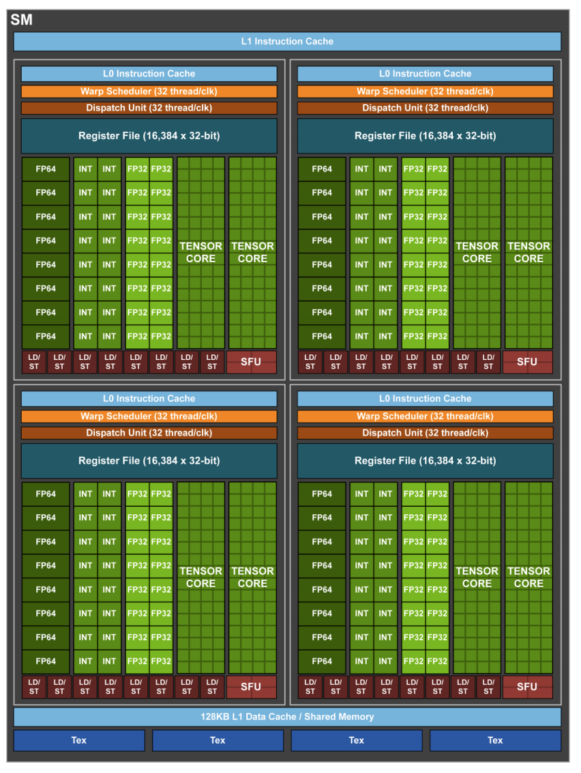
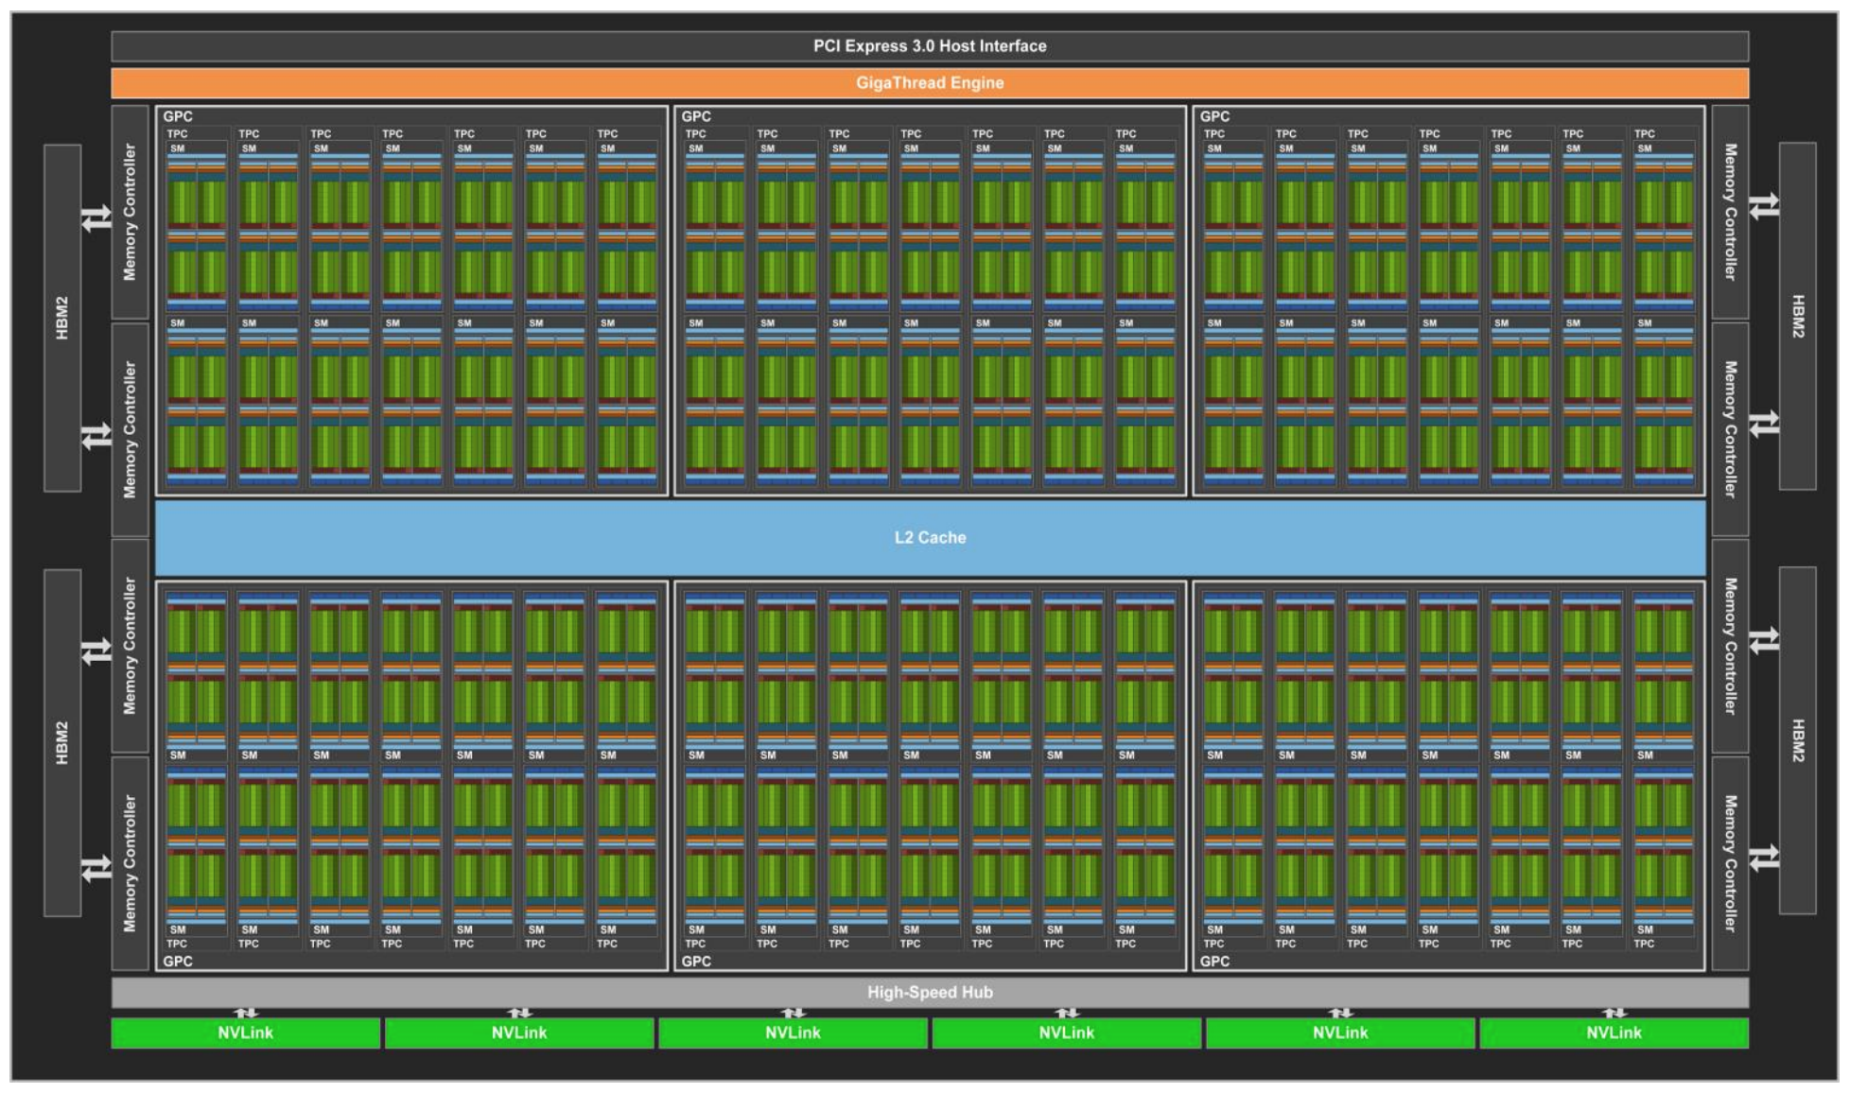
GPU Microarchitecture¹
NVidia GV100:
Hierarchical compute unit: SM=>TPC=>GPC=>GPU
Multi-level memory: L1/shmem=>L2=>HBM
GPGPU-Sim simulator models components above
[1]Volta Whitepaper. https://images.nvidia.com/content/volta-architecture/pdf/volta-architecture-whitepaper.pdf
Notes:
Completion criteria for ASC CSSE Milestone 6812.
Please see the last slide on how we have met each of these criteria.

Slide 9
GPGPU-Sim Introduction
GPGPU-Sim
Widely used GPU simulator in the research community (1300+ citations).
The third most cited simulator in computer architecture field (after GEM5(+GEMS) and SimpleScalar)
Functional model
Virtual ISA (vISA)
Machine ISA (mISA)
Performance model
Model microarchitecture timing relevant to GPU compute
Notes:
Impact statement from ASC CSSE Milestone 6812.
This is a stepping stone to achieve these goals; we still have some work to do. SST+GPU is the state-of-the-art in simulation capabilities. A literature review will reveal that, with this addition, SST provides more than other node-level simulation tool.
As we continue working on the GPU, memory, and interconnect models, we will get closer and closer to each of these impact statements.

Slide 10
GPGPU-Sim Introduction
GPGPU-Sim simulates kernel
Transfer data to GPU memory
GPU kernels runs on GPGPU-Sim:
Reports statistics for the kernels
Transfer data back to CPU memory
CPU
Async. Kernel Launch
GPU HW
GPGPU-Sim
Done
GPU HW
GPGPU-Sim
Blocking
Done
CPU
Sync. Kernel Launch
GPU HW
GPGPU-Sim
Done
CPU
Time
Notes:
Impact statement from ASC CSSE Milestone 6812.
This is a stepping stone to achieve these goals; we still have some work to do. SST+GPU is the state-of-the-art in simulation capabilities. A literature review will reveal that, with this addition, SST provides more than other node-level simulation tool.
As we continue working on the GPU, memory, and interconnect models, we will get closer and closer to each of these impact statements.

Slide 11
Functional model
Single Instruction Multiple Thread(SIMT):
SIMD + multithreading
Grid, Block, Warp, Thread
Virtual ISA vs. Machine ISA
vISA: PTX = Parallel Thread eXecution: virtual ISA defined by Nvidia
mISA: SASS = Native ISA for Nvidia GPUs
GPGPU-Sim use PTXPlus to represent SASS
1:1 mapping from SASS to PTXPlus
GPGPU-Sim supports:
PTX for new architectures(CUDA 10): new, inaccurate, well documented
SASS for architecture before Fermi(SM_1.X): old, accurate, less documented

Slide 12
Performance model
GPGPU-Sim models timing
SIMT Core
Caches and texture/constant/shared memory
Interconnection network(Booksim)
DRAM(GDDR5/HBM)
DO NOT model
Graphic Specific Hardware

Slide 13
GPUWattch: Power model
Estimate power consumed by the GPU according to the timing behavior
Ideal for evaluating fine-grained power management mechanisms
Validated with power measurements from GV100
Modified McPAT
Modifications: Specific micro-architectural components
Interface
Interface
GPGPU-Sim
Modifications: Add required performance counters
Performance counters
Feedback-driven Optimizations
Static Power
Dynamic Power
Detailed Performance Stats
Detailed Power Stats
A Comprehensive Framework for Performance and Energy Optimization Research
Notes:
Impact statement from ASC CSSE Milestone 6812.
This is a stepping stone to achieve these goals; we still have some work to do. SST+GPU is the state-of-the-art in simulation capabilities. A literature review will reveal that, with this addition, SST provides more than other node-level simulation tool.
As we continue working on the GPU, memory, and interconnect models, we will get closer and closer to each of these impact statements.

Slide 14
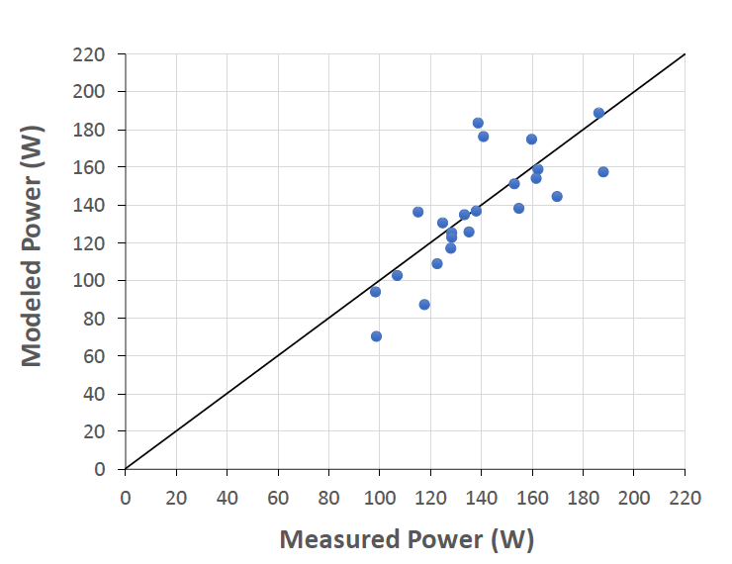
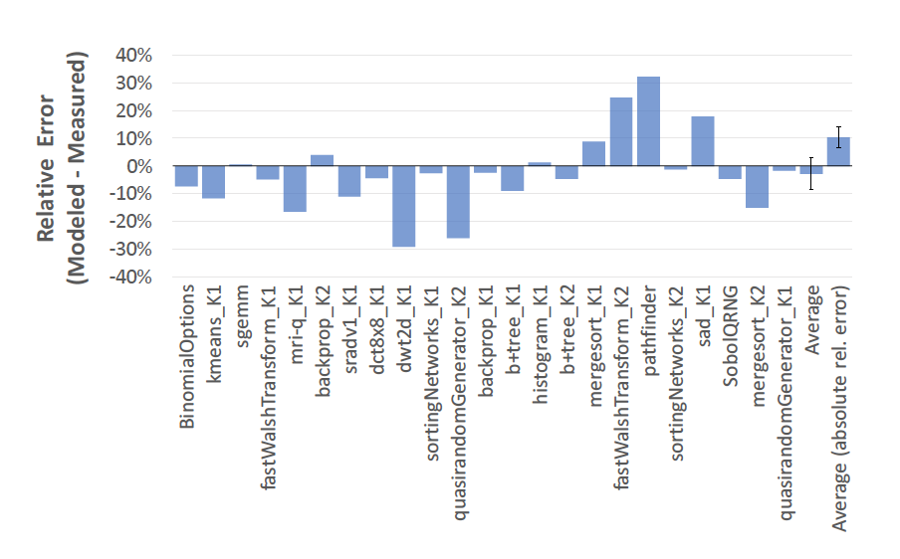
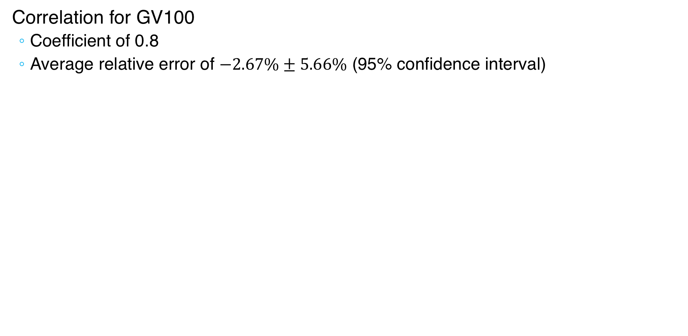
GPUWattch: Power model
Correlation for GV100
Coefficient of 0.8
Average relative error of $−2.67\%±5.66\%$ (95% confidence interval)
Notes:
Impact statement from ASC CSSE Milestone 6812.
This is a stepping stone to achieve these goals; we still have some work to do. SST+GPU is the state-of-the-art in simulation capabilities. A literature review will reveal that, with this addition, SST provides more than other node-level simulation tool.
As we continue working on the GPU, memory, and interconnect models, we will get closer and closer to each of these impact statements.

Slide 15
Outline
GPGPU-Sim Introduction
GPU and programming model
Functional model
Performance model
GPUWattch: power model
New Features in GPGPU-Sim
Volta model
Run closed source libraries
Tensor Core
Run CUTLASS library
Notes:
Description provided in ASC CSSE Milestone 6812.
Prior to this milestone, SST lacked the capability to model any external accelerator. We are now able to model a GPU accelerator in detail and analyze application and system behavior in fine detail.

Slide 16
New Feature: Volta Model Motivation
ISA cycle correlation¹ before new Volta model²
For Pascal Titan X
Benchmark | Means Abs Error |  | Correlation
 | vISA | mISA | vISA | mISA
Compute Intensive | 43.3% | 21.9% | 91.1% | 99.0%
Cache Sensitive | 104.8% | 100.4% | 81.2% | 82.0%
Memory Sensitive | 31.6% | 29.8% | 96.0% | 95.1%
Compute Balanced | 58.5% | 70.7% | 96.1% | 93.5%
Result
^{Compute intensive: mISA > vISA}
Cache sensitive: both show inaccurate cache model
Memory sensitive(streaming): not related to cache model
^{Compute balanced: vISA > mISA}
[1] Akshay Jain, Mahmoud Khairy, Timothy G. Rogers, A Quantitative Evaluation of Contemporary GPU Simulation Methodology. SIGMETRICS 2018
[2] Mahmoud Khairy, Jain Akshay, Tor Aamodt, Timothy G Rogers, Exploring Modern GPU Memory System Design Challenges through Accurate Modeling, arXiv:1810.07269
Notes:
Impact statement from ASC CSSE Milestone 6812.
This is a stepping stone to achieve these goals; we still have some work to do. SST+GPU is the state-of-the-art in simulation capabilities. A literature review will reveal that, with this addition, SST provides more than other node-level simulation tool.
As we continue working on the GPU, memory, and interconnect models, we will get closer and closer to each of these impact statements.

Slide 17
New features: Volta model¹
Fermi-based Model
SIMT Core
Memory Hierarchy
Warp
Scheduler
Exec Units
L1D cache/Shared Memory
Programmable-specified cache
L2 cache
Register File
(16 banks)
GDDR5 Model
SP
Instruction Cache
SP
Fermi coalescer
Warp
Scheduler
SFU
[1] Mahmoud Khairy, Jain Akshay, Tor Aamodt, Timothy G Rogers, Exploring Modern GPU Memory System Design Challenges through Accurate Modeling, arXiv:1810.07269
Notes:
Impact statement from ASC CSSE Milestone 6812.
This is a stepping stone to achieve these goals; we still have some work to do. SST+GPU is the state-of-the-art in simulation capabilities. A literature review will reveal that, with this addition, SST provides more than other node-level simulation tool.
As we continue working on the GPU, memory, and interconnect models, we will get closer and closer to each of these impact statements.

Slide 18
New features: Volta model¹
Volta-based Model
disaggregate RF
(2 banks)
Subcore model
+DP, INT, Tensor
SIMT Core
Memory Hierarchy
High-bandwidth Memory
Warp
Scheduler
Register File
SP
DP
SFU
INT
Tensor
Exec Units
Warp
Scheduler
Register File
SP
DP
SFU
INT
Tensor
Exec Units
L2 Cache
+Sectored, +memory copy engine model
+New Lazy_Fetch_on_Read write policy,
+partition-camping-aware hashing
L1D Cache / Shared Memory
+Sectored, +Adaptive cache (128 KB),
+Streaming cache +Banked
HBM
+ HBM Model, +dual-bus interface
+ Read/Write buffers
Volta coalescer (8 threads coalescer)
Instruction Cache
Warp
Scheduler
Register File
SP
DP
SFU
INT
Tensor
Exec Units
Warp
Scheduler
Register File
SP
DP
SFU
INT
Tensor
Exec Units
[1] Mahmoud Khairy, Jain Akshay, Tor Aamodt, Timothy G Rogers, Exploring Modern GPU Memory System Design Challenges through Accurate Modeling, arXiv:1810.07269
Notes:
Impact statement from ASC CSSE Milestone 6812.
This is a stepping stone to achieve these goals; we still have some work to do. SST+GPU is the state-of-the-art in simulation capabilities. A literature review will reveal that, with this addition, SST provides more than other node-level simulation tool.
As we continue working on the GPU, memory, and interconnect models, we will get closer and closer to each of these impact statements.

Slide 19
Hardware correlation for Volta model¹
Statistic | Means Abs Error |  | Correlation
 | Old Model | New Model | Old Model | New Model
Execution Cycles | 68% | 27% | 71% | 96%
L1 Reqs | 48% | 0.5% | 92% | 100%
L1 Hit Ratio | 41% | 18% | 89% | 93%
L2 Reads | 66% | 1% | 49% | 94%
L2 Writes | 56% | 1% | 99% | 100%
L2 Read Hits | 80% | 15% | 68% | 81%
DRAM Reads | 89% | 11% | 60% | 95%
2.5X error reduction
in exec time
0.5% error in L1 reqs
(96x reqs error reduction)
SIMT Core
Memory Hierarchy
1% error in L2 behavior
(66x read error reduction)
7X error reduction
in DRAM reads
[1] Mahmoud Khairy, Jain Akshay, Tor Aamodt, Timothy G Rogers, Exploring Modern GPU Memory System Design Challenges through Accurate Modeling, arXiv:1810.07269
Notes:
Impact statement from ASC CSSE Milestone 6812.
This is a stepping stone to achieve these goals; we still have some work to do. SST+GPU is the state-of-the-art in simulation capabilities. A literature review will reveal that, with this addition, SST provides more than other node-level simulation tool.
As we continue working on the GPU, memory, and interconnect models, we will get closer and closer to each of these impact statements.

Slide 20
Run closed source model¹
Run applications with cuDNN/cuBLAS
Static linking closed source libraries
LeNet for MNIST using cuDNN/cuBLAS
Executable
CUDA API layer
GPGPU-Sim
CUDA runtime API layer
Application
CUDA runtime API
static cuDNN library
Performance model
CUDA runtime API
static cuBLAS library
Functional model
[1] Jonathan Lew, Deval Shah, Suchita Pati, Shaylin Cattell, Mengchi Zhang, Amruth Sandhupatla, Christopher Ng, Negar Goli, Matthew D. Sinclair, Timothy G. Rogers, Tor M. Aamodt Analyzing Machine Learning Workloads Using a Detailed GPU Simulator, arXiv:1811.08933
Notes:
Impact statement from ASC CSSE Milestone 6812.
This is a stepping stone to achieve these goals; we still have some work to do. SST+GPU is the state-of-the-art in simulation capabilities. A literature review will reveal that, with this addition, SST provides more than other node-level simulation tool.
As we continue working on the GPU, memory, and interconnect models, we will get closer and closer to each of these impact statements.

Slide 21
Tensor Core in GV100
Accelerate FP operations
8 Tensor Core/SM
Each perform 64 FP FMA/clock
512 FMA/clock/SM
Or 1024 FP ops/clock/SM
Notes:
Impact statement from ASC CSSE Milestone 6812.
This is a stepping stone to achieve these goals; we still have some work to do. SST+GPU is the state-of-the-art in simulation capabilities. A literature review will reveal that, with this addition, SST provides more than other node-level simulation tool.
As we continue working on the GPU, memory, and interconnect models, we will get closer and closer to each of these impact statements.

Slide 22
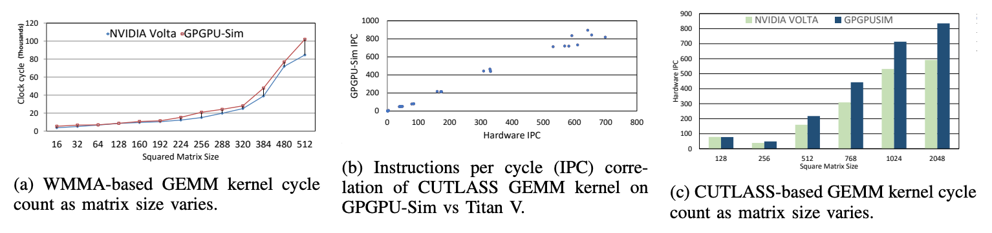
Tensor Core in Tesla Titan V¹
Standard deviation of less than 5%
99.60% IPC correlation
GPGPU-Sim shows higher perf than HW as matrix size increase
[1] Md Aamir Raihan, Negar Goli, Tor Aamodt, Modeling Deep Learning Accelerator Enabled GPUs, ISPASS 2019
Notes:
Impact statement from ASC CSSE Milestone 6812.
This is a stepping stone to achieve these goals; we still have some work to do. SST+GPU is the state-of-the-art in simulation capabilities. A literature review will reveal that, with this addition, SST provides more than other node-level simulation tool.
As we continue working on the GPU, memory, and interconnect models, we will get closer and closer to each of these impact statements.

Slide 23
Run CUTLASS library
Combine CUTLASS, tensor core¹, and volta model²
Correlation: using Deepbench training/inference test from real scenario
[1] Md Aamir Raihan, Negar Goli, Tor Aamodt, Modeling Deep Learning Accelerator Enabled GPUs, ISPASS 2019
[2] Mahmoud Khairy, Jain Akshay, Tor Aamodt, Timothy G Rogers, Exploring Modern GPU Memory System Design Challenges through Accurate Modeling, arXiv:1810.07269
Notes:
Impact statement from ASC CSSE Milestone 6812.
This is a stepping stone to achieve these goals; we still have some work to do. SST+GPU is the state-of-the-art in simulation capabilities. A literature review will reveal that, with this addition, SST provides more than other node-level simulation tool.
As we continue working on the GPU, memory, and interconnect models, we will get closer and closer to each of these impact statements.

Slide 24
Summary
GPGPU-Sim:
Simulates GPU compute unit and memory hierarchies.
an evolutional simulator for new features in CUDA and GPUs.
actively including new features
GPGPU-Sim with SST:
GPGPU-Sim brings promising GPU model to SST
GPGPU-Sim benefits for SST parallel simulation architecture
Notes:
Description provided in ASC CSSE Milestone 6812.
Prior to this milestone, SST lacked the capability to model any external accelerator. We are now able to model a GPU accelerator in detail and analyze application and system behavior in fine detail.

Slide 25


Slide 26
Backup Slides

Slide 27
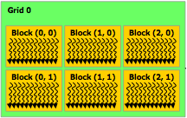
Thread Hierarchy Revisited
Recall, kernel = grid of blocks of warps of threads
Threads are grouped into warps in hardware
Source: NVIDIA
SIMT Core
Each block is dispatched to a SIMT core as a unit of work: All of its warps run in the core’s pipeline until they are all done.
32 Threads
Thread Block
(CTA)
32 Threads
Thread Block
(CTA)
32 Threads
Thread Block
(CTA)
32 Threads
32 Threads
32 Threads
32 Threads
32 Threads
32 Threads
Warps

Slide 28
Inside a SIMT Core
Done (Warp ID)
SIMT
Front End
Reg
File
SIMD Datapath
Fetch
Decode
Memory Subsystem
Icnt.
Network
Schedule
Branch
SMem
L1 D$
Tex $
Const$
Fine-grained multithreading
Interleave warp execution to hide latency
Register values of all threads stays in core

Slide 29
SIMT Stack
foo[] = {4,8,12,16};
One stack per warp
A: v = foo[tid.x];
B: if (v < 10)
C: v = 0;
else
D: v = 10;
E: w = bar[tid.x]+v;
A
T1
T2
T3
T4
SIMT Stack
B
T1
T2
T3
T4
PC
RPC
Active Mask
B
E
-
-
1111
1111
C
T1
T2
D
E
0011
D
C
E
1100
T3
T4
E
T1
T2
T3
T4
Time
Handles Branch Divergence

Slide 30
Constant Cache
A Read-only cache for constant memory
GPGPU-Sim simulates 1 read ports
A warp can access 1 constant cache locations in a single memory unit cycle
If more than 1 locations accessed
reads are serialized causing pipeline stalls
# of ports is not configurable

Slide 31
Coalescing
Combining memory accesses made by threads in a warp into fewer transactions
E.g. if threads in a warp are accessing consecutive 4-byte sized locations in memory
Send one 128–byte request to DRAM (coalescing)
Instead of 32 4-byte requests
This reduces the number of transactions between SIMT cores and DRAM
Less work for Interconnect, Memory Partition and DRAM

Slide 32
Interconnection Network Model
Intersim (Booksim) a flit level simulator
Topologies (Mesh, Torus, Butterfly, …)
Routing (Dimension Order, Adaptive, etc. )
Flow Control (Virtual Channels, Credits)
We simulate two separate networks
From SIMT cores to memory partitions
Read Requests, Write Requests
From memory partitions to SIMT cores
Read Replies, Write Acks

Slide 33
PTX
Low-level data-parallel virtual ISA
Instruction level
Unlimited registers
Parallel threads running in blocks; barrier synchronization instruction
Scalar ISA
SIMT execution model
Intermediate representation in CUDA tool chain
Fermi
.cu
NVCC
Kepler
PTX
ptxas
Maxwell
.cl
OpenCL Drv
Pascal
Volta
Notes:
Impact statement from ASC CSSE Milestone 6812.
This is a stepping stone to achieve these goals; we still have some work to do. SST+GPU is the state-of-the-art in simulation capabilities. A literature review will reveal that, with this addition, SST provides more than other node-level simulation tool.
As we continue working on the GPU, memory, and interconnect models, we will get closer and closer to each of these impact statements.

Slide 34
SASS
Native ISA for Nvidia GPUs
Better correlation with HW but less documented
Related with Stream Multiprocessor(SM) version.
Scalar ISA
GPGPU-Sim use PTXPlus to represent both SASS and PTX
SASS mapped 1:1 into PTXPlus instruction
CUDA
Executable
cuobjdump
SASS
conversion
PTXPlus
Notes:
Impact statement from ASC CSSE Milestone 6812.
This is a stepping stone to achieve these goals; we still have some work to do. SST+GPU is the state-of-the-art in simulation capabilities. A literature review will reveal that, with this addition, SST provides more than other node-level simulation tool.
As we continue working on the GPU, memory, and interconnect models, we will get closer and closer to each of these impact statements.

Slide 35
PTX vs. SASS
PTX
$Lt_25_13570:
ld.global.s32 %r9, [%rd5+0];
add.s32 %r10, %r9, %r8;
ld.global.s32 %r11, [%rd5+1024];
add.s32 %r8, %r11, %r10;
add.u32 %r5, %r7, %r5;
add.u64 %rd5, %rd5, %rd6;
ld.param.u32 %r6, [size];
setp.lt.u32 %p2, %r5, %r6;
@%p2 bra $Lt_25_13570;
...
mov.u32 %r12, 127;
setp.gt.u32 %p3, %r3, %r12;
@%p3 bra $Lt_25_14082;
ld.shared.s32 %r13, [%rd10+512];
add.s32 %r8, %r13, %r8;
st.shared.s32 [%rd10+0], %r8;
$Lt_25_14082:
bar.sync 0;
SASS (PTXPlus)
l0x00000060:
add.half.u32 $r7, $r4, 0x00000400;
ld.global.u32 $r8, [$r4];
ld.global.u32 $r7, [$r7];
add.half.u32 $r0, $r5, $r0;
add.half.u32 $r6, $r8, $r6;
set.gt.u32.u32 $p0/$o127, s[0x0020], $r0;
add.half.u32 $r6, $r7, $r6;
add.half.u32 $r4, $r4, $r3;
@$p0.ne bra l0x00000060;
...
set.gt.u32.u32 $p0/$o127, $r2, const [0x0000];
@$p0.equ add.u32 $ofs2, $ofs1, 0x00000230;
@$p0.equ add.u32 $r6, s[$ofs2+0x0000], $r6;
@$p0.equ mov.u32 s[$ofs1+0x0030], $r6;
bar.sync 0x00000000;

Slide 36
Interfacing GPGPU-Sim to applications
GPGPU-Sim compiles into a shared runtime library and implements the API:
libcudart.so ← CUDA runtime API
libOpenCL.so ← OpenCL API
CUDA runtime API
Application
libcudart.so
User level
CUDA Driver
Operating system
Hardware
GPU hardware
Notes:
Impact statement from ASC CSSE Milestone 6812.
This is a stepping stone to achieve these goals; we still have some work to do. SST+GPU is the state-of-the-art in simulation capabilities. A literature review will reveal that, with this addition, SST provides more than other node-level simulation tool.
As we continue working on the GPU, memory, and interconnect models, we will get closer and closer to each of these impact statements.

Slide 37
Interfacing GPGPU-Sim to applications
GPGPU-Sim compiles into a shared runtime library and implements the API:
libcudart.so ← CUDA runtime API
libOpenCL.so ← OpenCL API
CUDA runtime API
CUDA API layer
libcudart.so
Application
CUDA runtime API layer
Performance model
Functional model
Notes:
Impact statement from ASC CSSE Milestone 6812.
This is a stepping stone to achieve these goals; we still have some work to do. SST+GPU is the state-of-the-art in simulation capabilities. A literature review will reveal that, with this addition, SST provides more than other node-level simulation tool.
As we continue working on the GPU, memory, and interconnect models, we will get closer and closer to each of these impact statements.

Slide 38
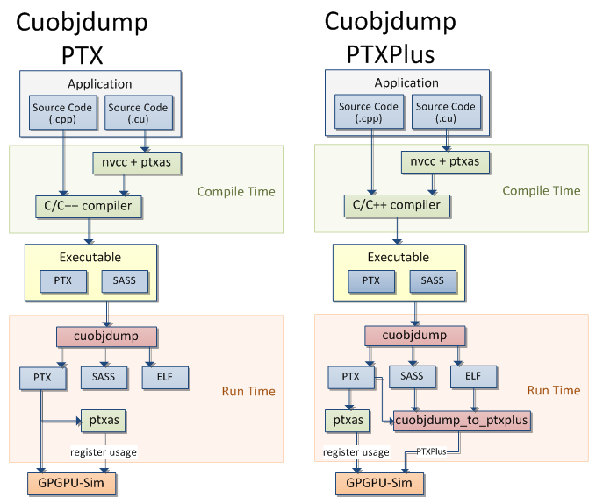
GPGPU-Sim Runtime Flow
Notes:
Impact statement from ASC CSSE Milestone 6812.
This is a stepping stone to achieve these goals; we still have some work to do. SST+GPU is the state-of-the-art in simulation capabilities. A literature review will reveal that, with this addition, SST provides more than other node-level simulation tool.
As we continue working on the GPU, memory, and interconnect models, we will get closer and closer to each of these impact statements.

Slide 39
Slide Left Blank

